Slide 1
PSNH Enterprise GIS
Building a System from the Ground Up
NH GIS Advisory Committee Meeting
September 17, 2014
Energy Park, Manchester, NH
Geoff Bechtold & Ron Rioux

Slide 2
AGENDA
Introductions
Message about NU Safety
Lay of the Land
Conversion Process - Data, Data, and Data
NU Enterprise GIS Platform
eGIS Silverlight Web Viewer demo
Python for ArcGIS and Automation
Where do we go from here…

Slide 3
SAFETY FIRST
#1 - ALL INJURIES ARE PREVENTABLE
PREVENTABLE MOTOR VEHICLE ACCIDENTS
NU POLICY – SAFETY CONES VISIBLE
FIRST MOVE FROM PARK
BACK INTO SPACES
PULL THROUGH OPEN SPACES

Slide 4

PSNH Business Organizations
  Generation – 31 units @ 14 locations.
    Solar, Wood, Hydro, Coal, and Natural Gas
  Transmission – Interconnect Generating Stations to Distribution Substations
  Distribution – Servicing over 500,000 customers

Slide 5
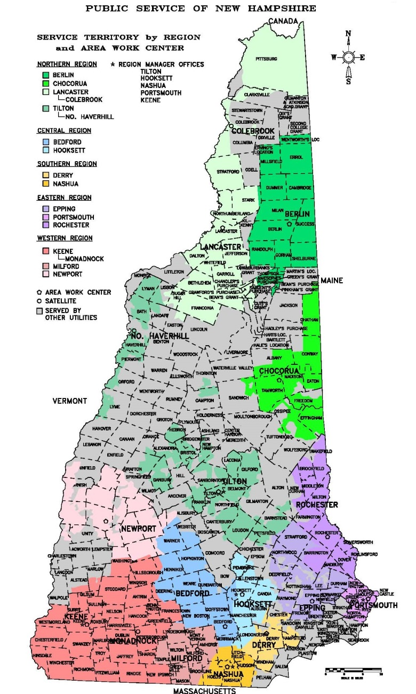
By the Numbers…
5,800 Square Miles Served
237 Cities and Towns
14 Area Work Centers and 3 Satellite Offices
847 Distribution Circuits
13,000 Miles of Primary Line
168 Distribution Substations
500,000+ Customer Meters
444,000 Poles
135,000 Transformer Banks
33,000 Fused Cutout Banks
4,326,715 Objects Translated

Slide 6
Project Timeline
2010 - Approached NH PUC
NH PUC – Pre-Approved / 5 year implementation.
PSNH GIS Steering Committee formed.
2010-2011 - RFP and Vendor bid selection.
Project Methodology Office (PMO) and Consultant hired.
PSNH GIS Team positions hired:
  Project Manager
  Business Process Coordinator
  Data Conversion Lead Analyst.
2011 (Fall) - Requirements workshops.

Slide 7
Conversion Key Highlights
49kV and below Distribution.
Conversion schedule - September 2011 to October 2013.
Production Cycle – 18 months.
Extract-Translate-Load (ETL) - Smallworld to Microstation to Smallworld.
98% accuracy or greater required.
100% Passing DistriView engineering model.
Sync to Oracle Spatial and SDE (ESRI).

Slide 8
Conversion Design Specifications
Attribute Mapping
Source Data Matrix
Specification Manual
Extract – Translate – Load
Feedback
Verification
Acceptance

Slide 9
GIS Architecture
Applications
Users
GE Smallworld
(Version Managed Datastore)
Oracle Spatial
ESRI Presentation Layer
ESRI
Applications
COTS
Applications
ESRI Data Bus
GIS
Maintenance

Slide 10
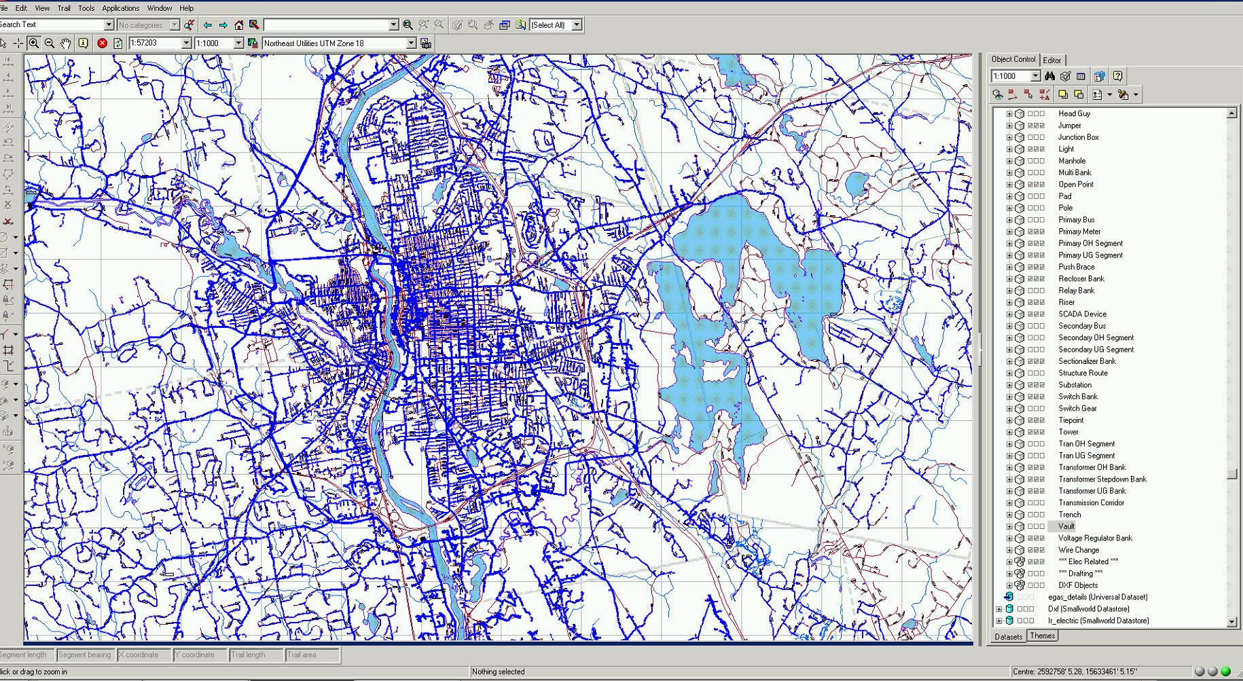
GE Smallworld – Northeast Utilities ENOM Model

Slide 11
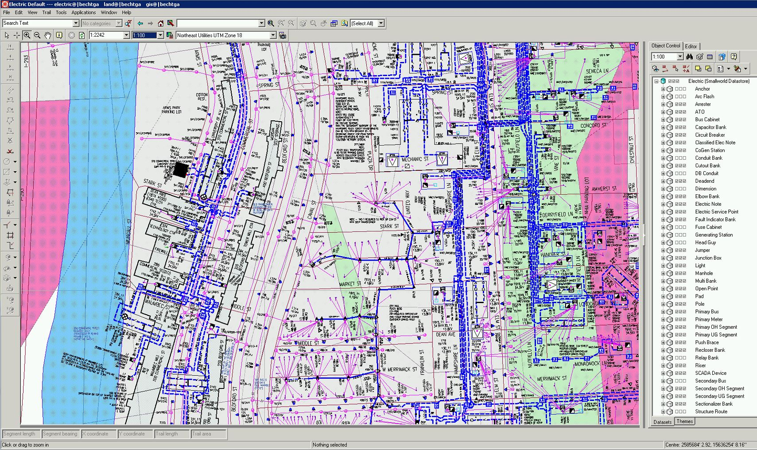
GE Smallworld – Northeast Utilities ENOM Model

Slide 12
Conversion Delivery Schedule
PROTOTYPE – Small subset of circuits and substations.
PILOT – Part of an Area Work Center, roughly 10% of a delivery.
PRODUCTION – Area Work Centers (AWC)
  Pittsfield
  Franklin
  Laconia
  Chocorua
  Lancaster
  Berlin
  Portsmouth and Epping: Combined for scheduling constraints.
  Rochester
  Derry
  Hooksett
  Nashua
  Bedford
  Milford
  Hillsborough
  Monadnock and Keene: Combined for scheduling constraints.
  Newport

Slide 13
Preparing Source Data
  Customer database extract.
  Asset databases extracts.
  AutoCAD maps for Primary and URD circuits.
  Distribution Milesheet R.O.W. maps.
  GPS positions for Distribution R.O.W. lines.
  Electric System Area Switching diagrams.
  Phase Connection diagrams.
  Substation One-Line diagrams.
  Network Underground Manhole/Vault diagrams.
  VIP customer lists.

Slide 14
Source Data vs. Actuals

Slide 15
Equipment in Service vs. Inventory

Slide 16
Field Verification (Scrubbing)
PSNH Retirees - Knowledge of Distribution System
AWC schedule - Geographic locations
Identified gaps - Data sources
Electrical connectivity issues
Markups - Preparation for source data submission
Open Points - Underground Residential Development
Detailed Sector Cabinets
Results - Vendor questions reduced

Slide 17
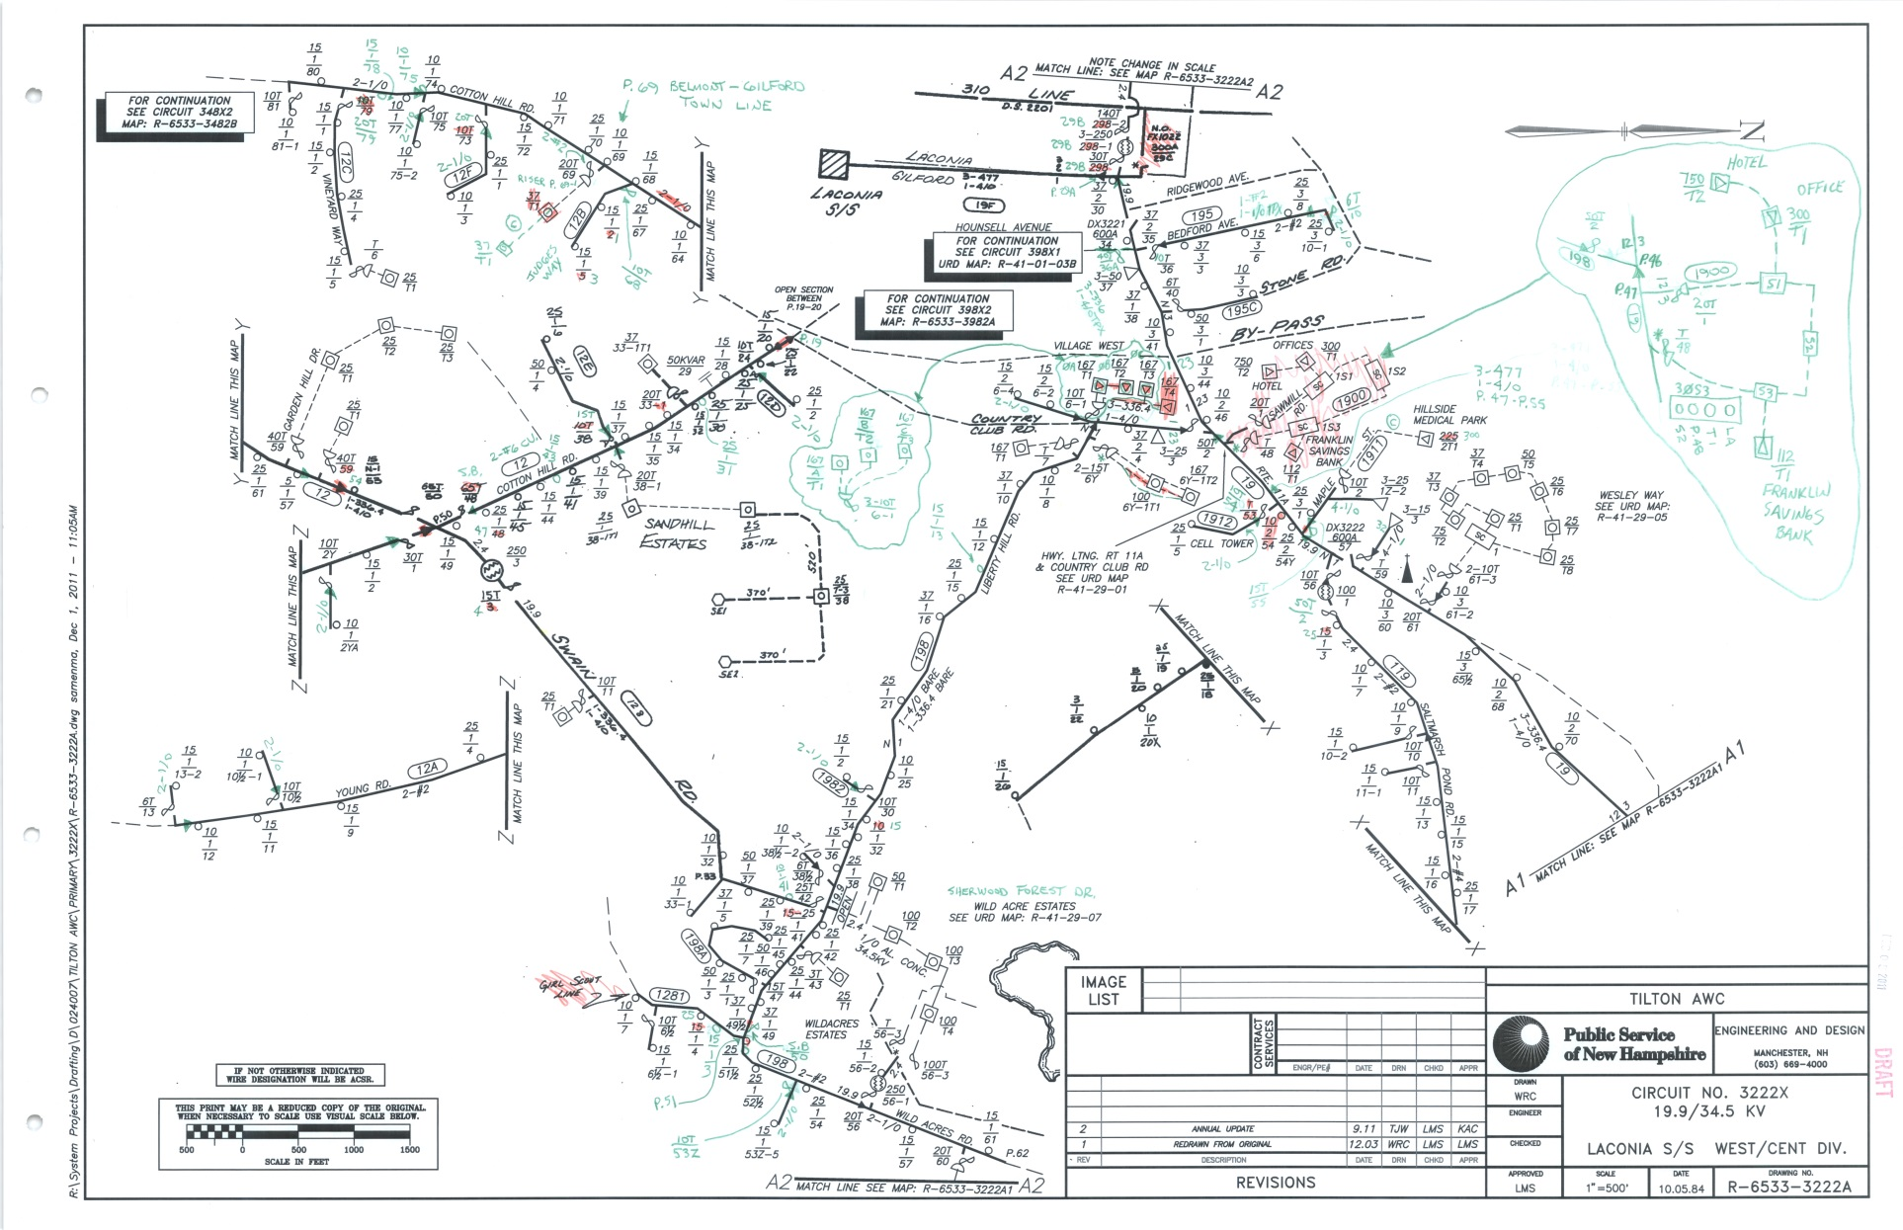
Field Markups – OH Maps

Slide 18
Field Markups – URD Maps

Slide 19
Data QA/QC
Internal NU Team
Action Item log
Database analysis:
  High impact Electric devices
  Connectivity.
Track issues using MS Access
Feedback to Vendor
Modify PSNH Specification document and Business Rules
100% QA/QC verification for the first 6 deliveries
50% map verification for remaining deliveries
Maintained Vendor’s effort and quality
Results: On time, within budget, 100% accepted

Slide 20
Northeast Utilities Enterprise GIS Platform
GE Smallworld Datastore
Oracle Spatial 11g Database
ESRI ArcSDE Database Views
ArcGIS for Server - Silverlight Web Portal
EPOCH Field Tablet Viewer
Smallworld on Garmin POI Creator
Oracle EDS Extractor Enterprise Outage Management System
Clearion Damage Assessment Viewer
Work Studio Vegetation Management

Slide 21
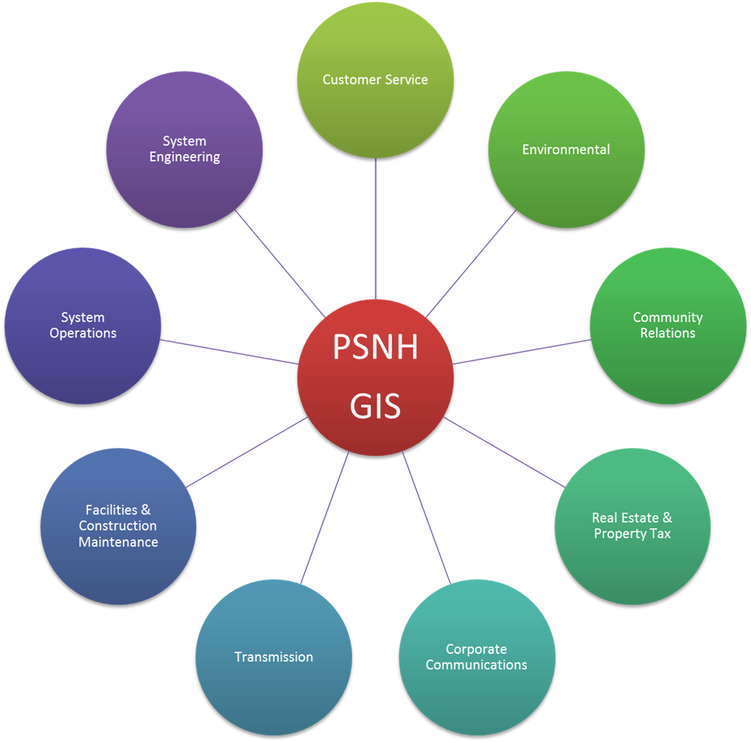

Slide 22
eGIS Silverlight Web Portal
100’s of users
ESRI ArcMap
10-50 users
SmallWorld
5-20 users

Slide 23
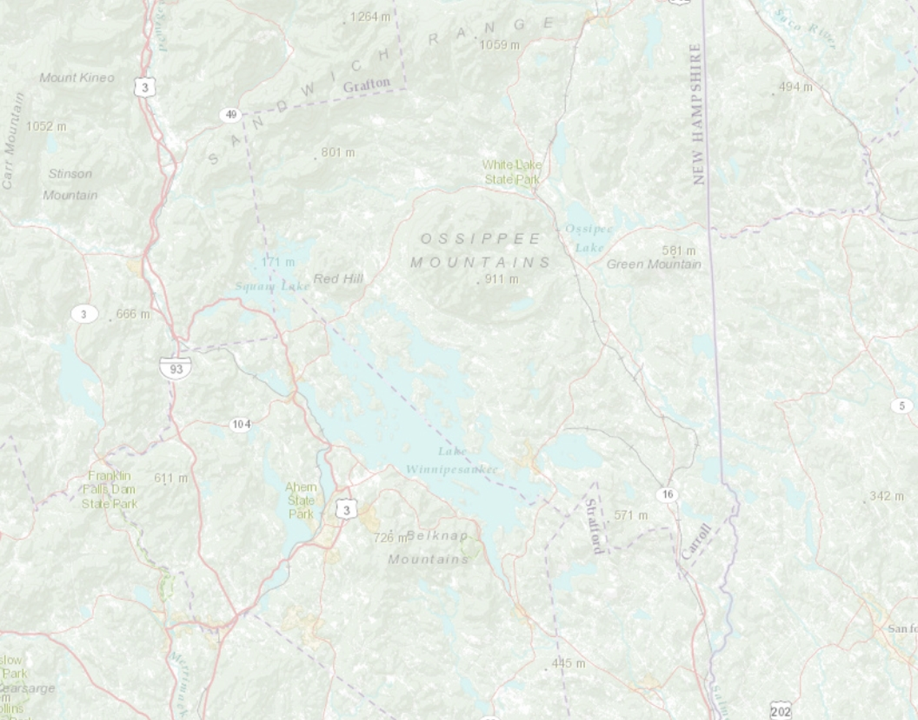
ArcGIS for Server - Silverlight Web Portal
Online mapping tool from Microsoft and ESRI
Silverlight API
ArcGIS for Server 10.0
Cached - Land, GIS, and Electric objects
Builds nightly post-Oracle Sync
Highlights
  WMS Base maps from Esri
  Save bookmarks & user settings
  Address, asset, & coordinate search
  Google Streetview and Bing Birdseye
  Attribute editor, markup, & drawing tools
  Network Trace
  Supports File Geodatabases as a Service
  Import ArcGIS Web Maps as a WMS layer

Slide 24
ArcGIS for Server - Siverlight Web Portal
eGIS DEMO

Slide 25















PSNH GIS Partners
Data Vendors Hardware Vendors
http://www.granit.unh.edu/ http://www.shopfujitsu.com/index.php
http://www.census.gov/ http://www.garmin.com/en-US
http://www.t2.unh.edu/ Consulting Vendors
http://www.boreasgroup.us/
http://www.revenue.nh.gov/ http://www.guidantgroup.com/en-US/Pages/default.aspx
Software Vendors
http://www.esri.com/ http://www.copyexpress.com/
Software Vendors
http://www.gedigitalenergy.com/ http://www.aspeninc.com/web/index.html
geospatial/catalog/smallworld_core.htm
http://www.safe.com/
http://www.oracle.com/technetwork/database/ options/spatialandgraph/overview/index.html
http://ramtech-corp.com/ http://www.spatialbiz.com/
http://www.epochsg.com/ http://www.ubisense.net/en/index.html

Slide 26
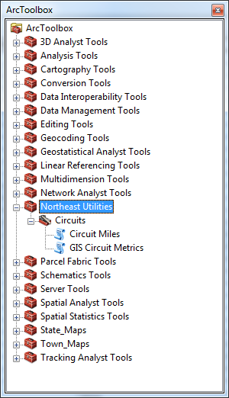
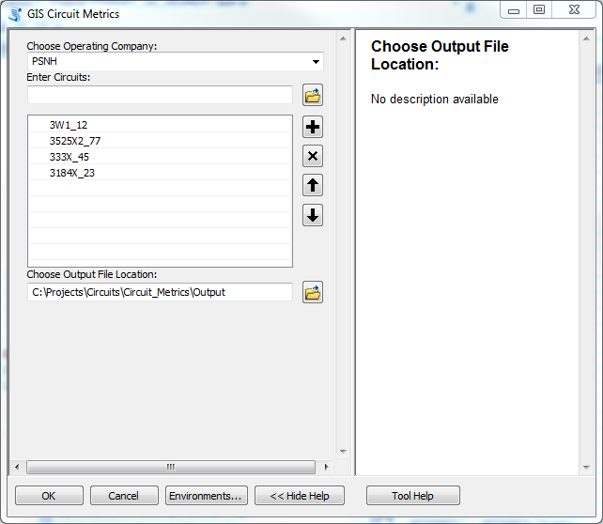
Python for ArcGIS

Slide 27
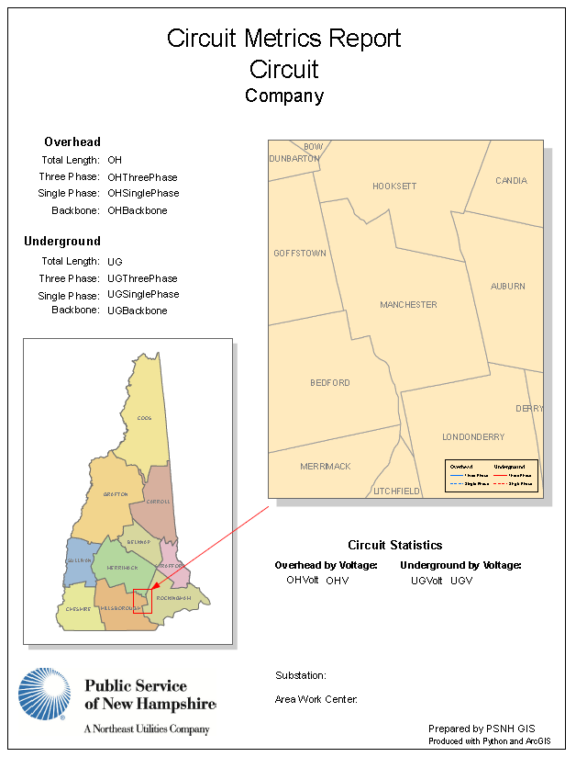
Circuit Report Template

Slide 28
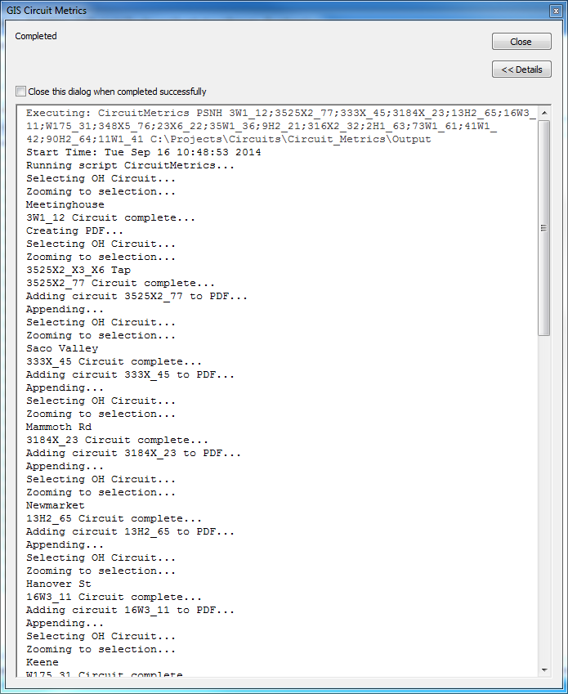
GIS Circuit Metrics Report

Slide 29
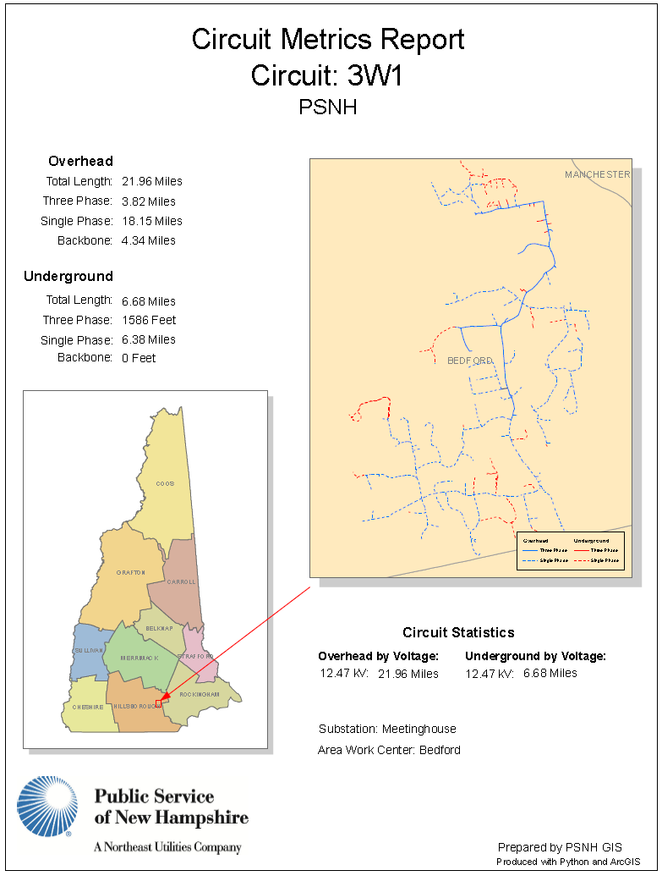
GIS Circuit Metrics Report (PDF)

Slide 30
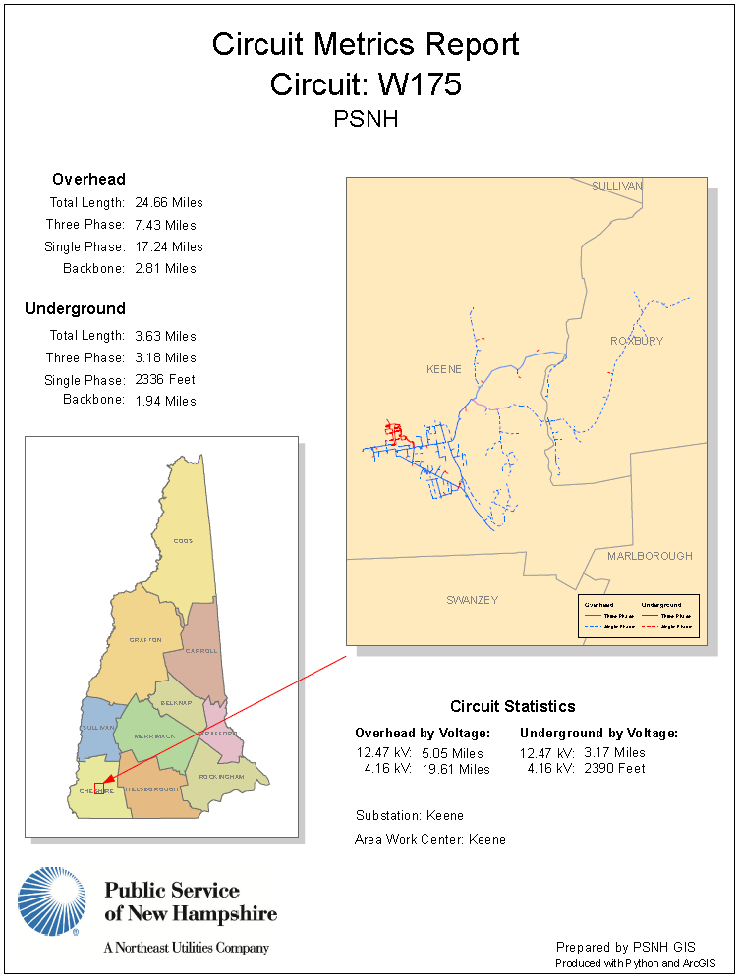
GIS Circuit Metrics Report (PDF)

Slide 31
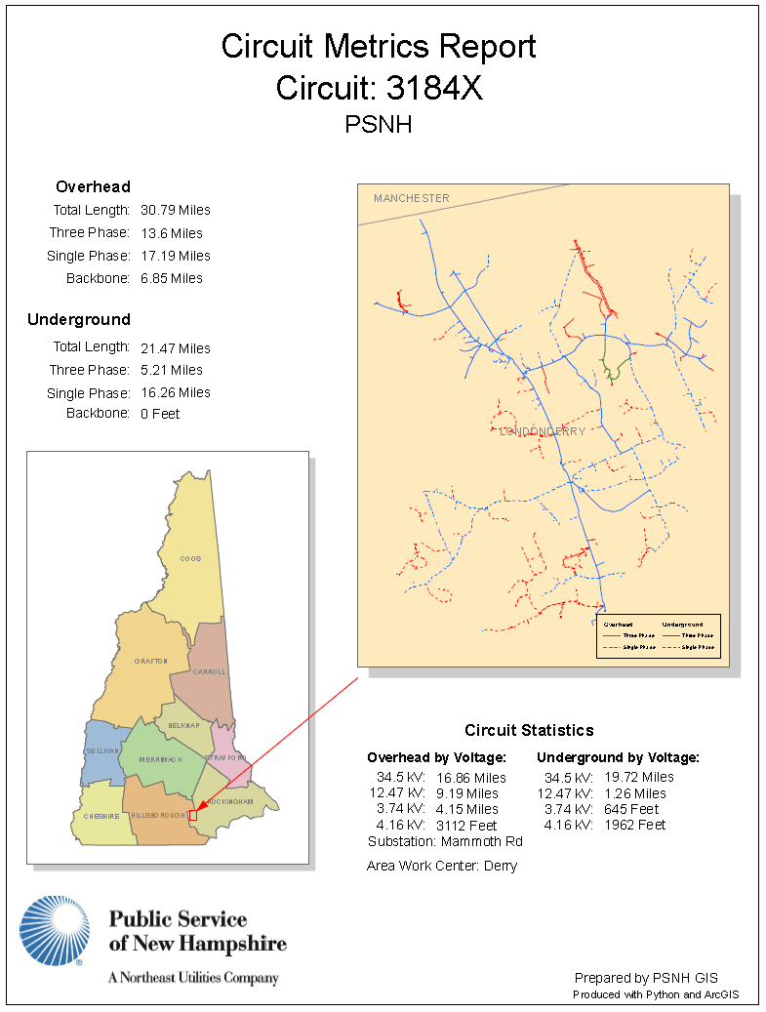
GIS Circuit Metrics Report (PDF)

Slide 32
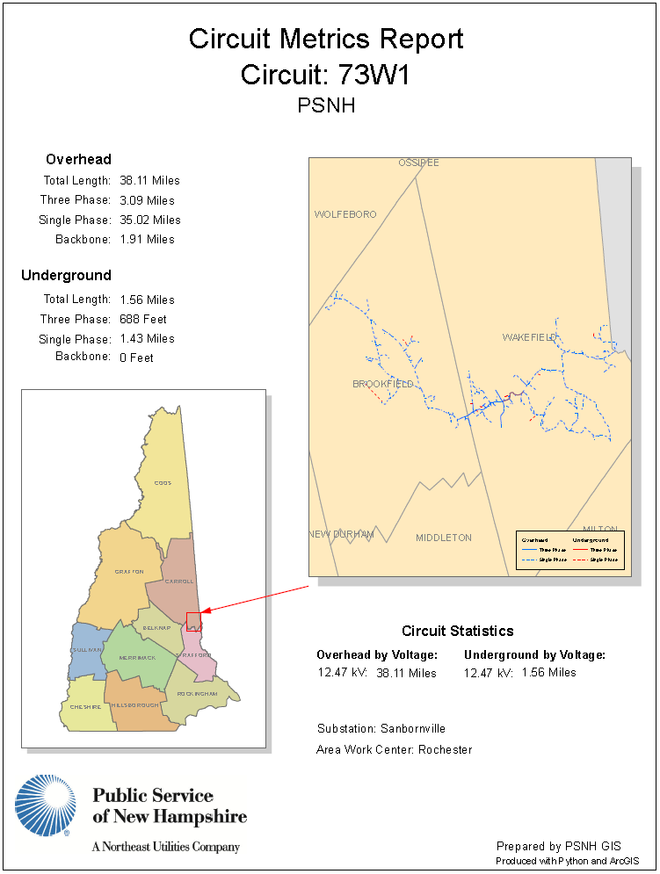
GIS Circuit Metrics Report (PDF)

