Slide 1
NH Rural Addressing
Project Update
December 2011

Slide 2
PROJECT OVERVIEW
Purpose
Create the first publically available master address file in NH
Focus on underserved areas
Dataset will benefit statewide Broadband mapping and planning efforts
Provide communities/public with a direct investment in Broadband project, GPS and GIS technologies
Funding
$344,523 for NRPC
Subcontract allocations to other participating RPCs
Timeline
Years 2-4 of overall Broadband project
Completion date – December 2013

Slide 3
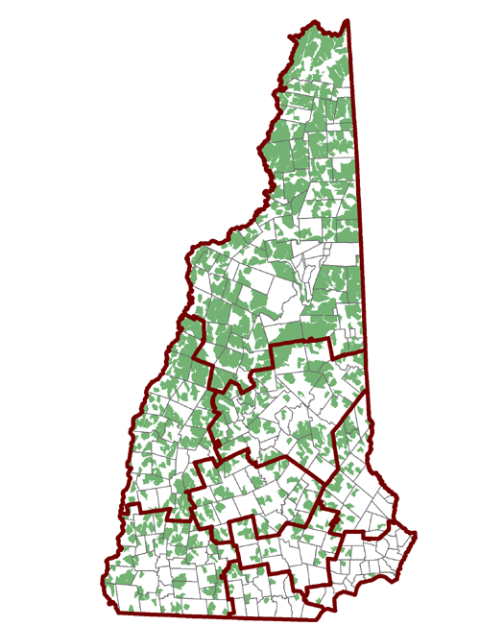
PROJECT OVERVIEW
Workload
Every address in a rural Census block (2+ square miles)
698 rural blocks
39,991 households per 2010 Census
Rural blocks in 199 of 259 NH political divisions
RPC Code | RPC Name | Rural HH | Rural Blocks | Rural Towns
1 | NCC | 12617 | 257 | 61
2 | Lakes | 6806 | 102 | 29
3 | Upper Valley | 5794 | 116 | 25
4 | Southwest | 3720 | 85 | 32
5 | Central | 3612 | 59 | 20
6 | Southern | 3325 | 25 | 9
7 | Nashua | 1428 | 14 | 8
8 | Rockingham | 596 | 5 | 4
9 | Strafford | 2093 | 35 | 11
 | Grand Total | 39991 | 698 | 199

Slide 4
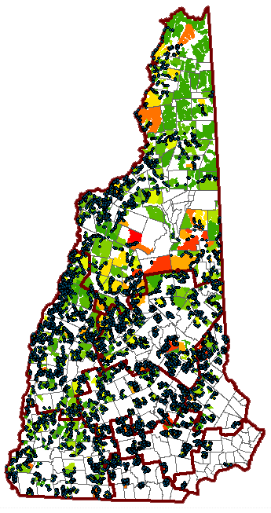
EXISTING DATA
RPC Inventory
Pre-existing points
Digital parcels
Assessing data
Other Inventory
Cartographic Associates
Avitar
DRA Mosaic Parcel Map
Reference USA
Commercial dataset with 568,000+ records
Removed records matched to zip code level only
Removed records with no numbered street address
Geocoded remaining 443,000+ points to XY coordinates and intersected with rural census blocks
RESULT – 22,522 POINTS

Slide 5
PROJECT STANDARDS REQUIRED INPUT DATA
Feature class template in an Arc10 geodatabase
Reference USA geocoded points in rural blocks
Digital parcels and assessing data where available
RPCs responsible for collecting and joining data
UNH and NRPC can provide support where needed
Field maps for GPSing
Aerial photography
2010 1-foot DOT
Latest 1-meter NAIP

Slide 6
PROJECT STANDARDS DATA COLLECTION PROCEDURES
NRPC completes gap analysis and identifies areas for field data collection
RPCs organize GPS volunteer groups
NRPC coordinates purchase of GPS units
NRPC coordinates training sessions
NRPC distributes field maps to each region
Volunteer teams collect GPS data

Slide 7
PROJECT STANDARDS DATA PROCESSING PROCEDURES
RPCs download GPS data
RPCs prepare parcels and assessing records
May require initial acquisition
RPCs receive input data from NRPC
Geodatabase with Reference USA points
Field maps
RPCs screen-edit all points to residential rooftops

Slide 8
PROJECT STANDARDS DATA SUBMITTAL PROCEDURES
RPCs submit completed addresses to NRPC
Monthly schedule at first
Pre-arranged target number of points per submission
NRPC checks and combines data in master geodatabase and submits to UNH
UNH delivers to NTIA

Slide 9
PROJECT STANDARDS DATA MODEL
Street Address
Prefix
House number
Street
Suffix
Units (Y/N)
Address Range
Community
Address community where different
Zip Code
Point Metadata
Parcel ID where possible
RPC

Slide 10
DETERMING WORK SHARE
Gap Analysis and Inventory
Revealed two major situations
GPS Data Collection
Used mainly in towns where digital parcels and assessing data are not available
Collected points then move to on-screen category
Task hours assigned to volunteer time only
On-Screen Processing
Move GPS points to rooftop location
Move pre-existing points to rooftop location
Create points using digital parcels and assessing data

Slide 11
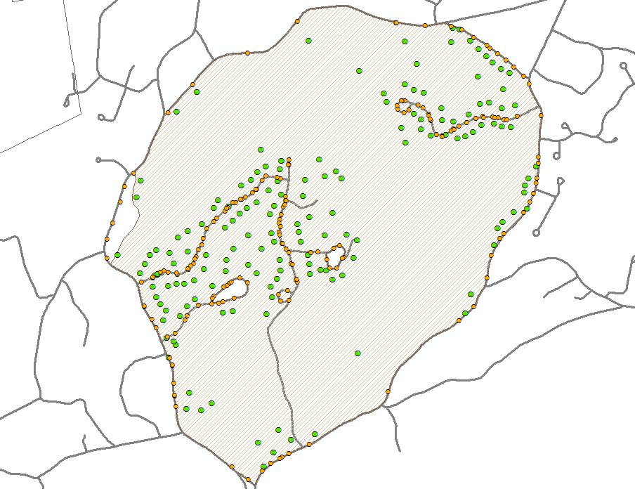
DETERMINING WORK SHARE GPS EXAMPLE
Hollis – 181 households (2010 Census)
Collected 177 points
Failed to collect 7 points
Collected 7-10 positions per point with Trimble unit
House number only
Tracked time to collect points
2 hours

Slide 12
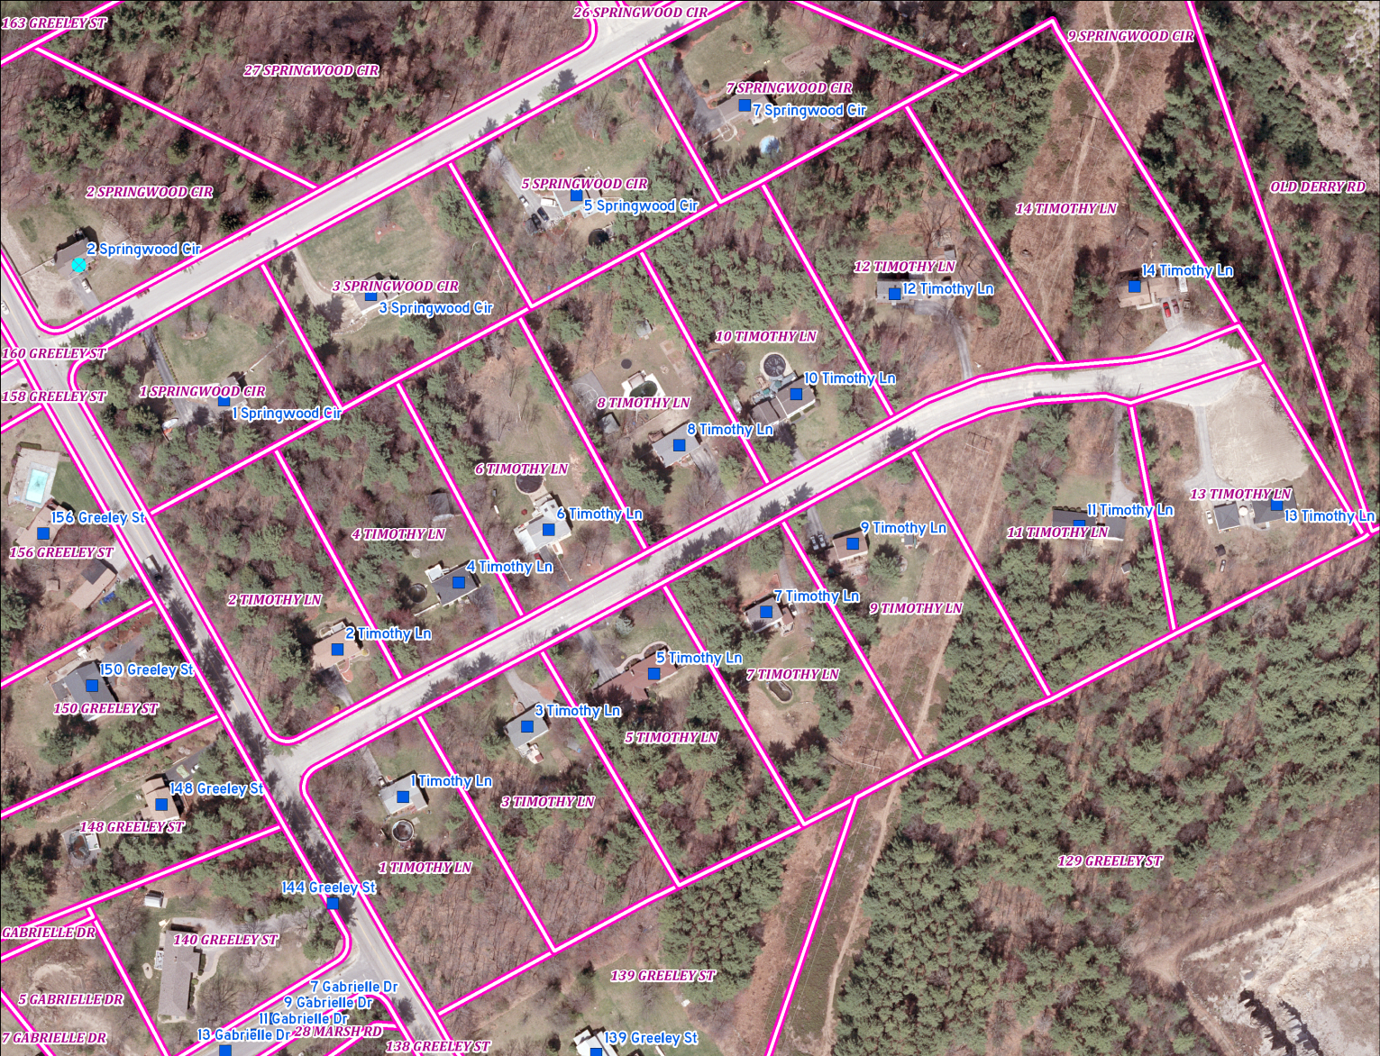
DETERMINING WORK SHARE ON-SCREEN EXAMPLE
Hudson
312 Census HH
312 geocoded records (289 usable)
Tracked time to move all points to rooftops
About 20 seconds per point

Slide 13
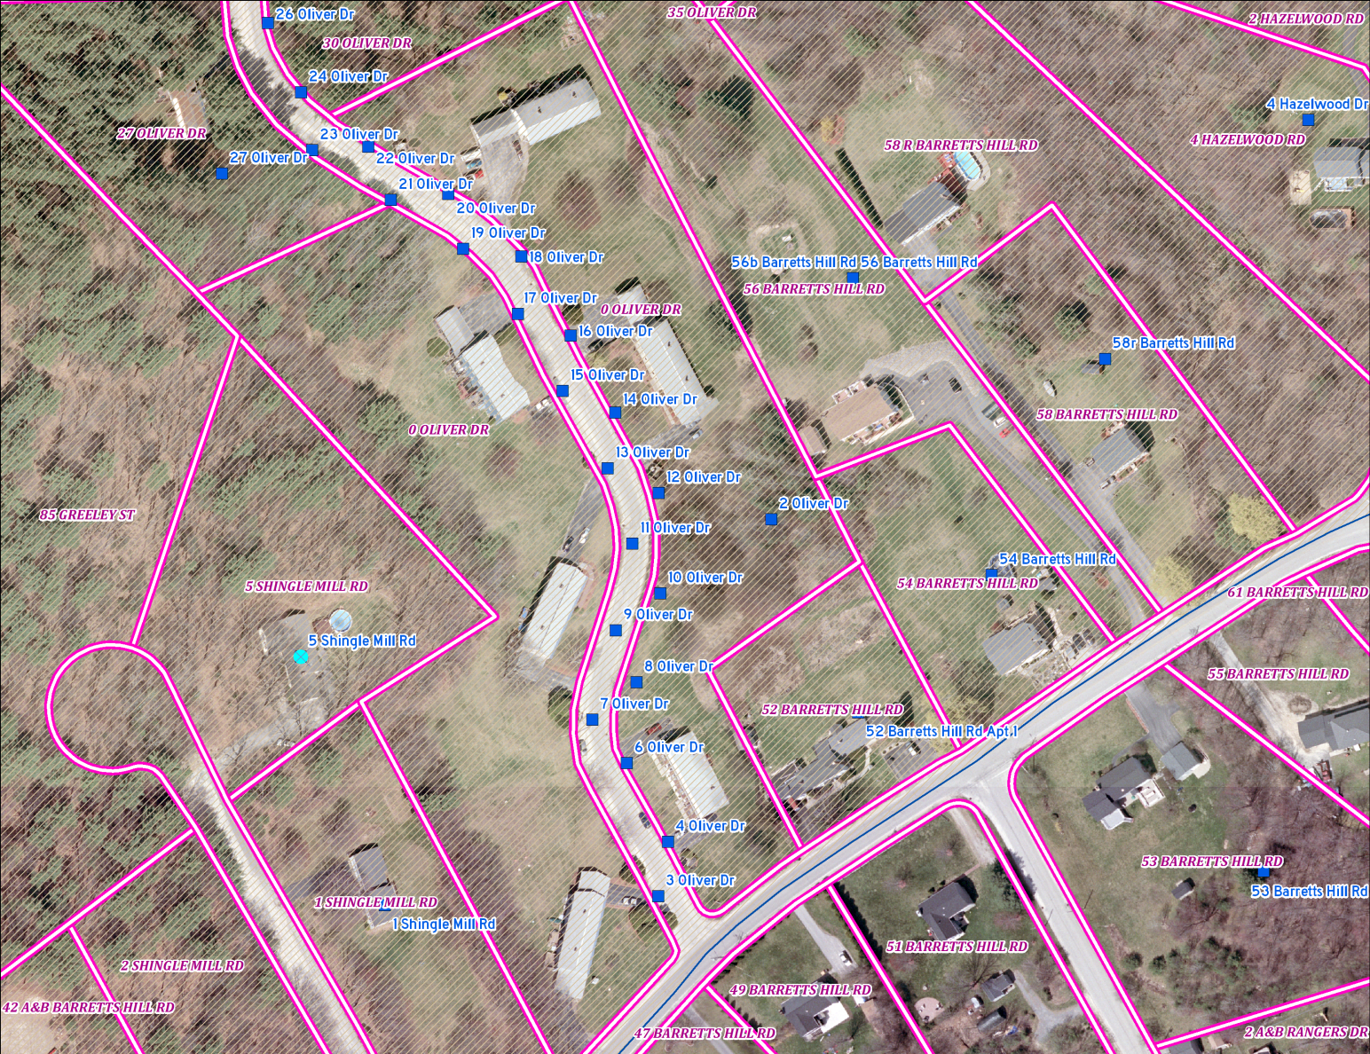
DETERMINING WORK SHARE ON-SCREEN EXAMPLE
Hudson
Data issues
20 parcels had no address point record
Multi-unit bldgs represented by one point

Slide 14
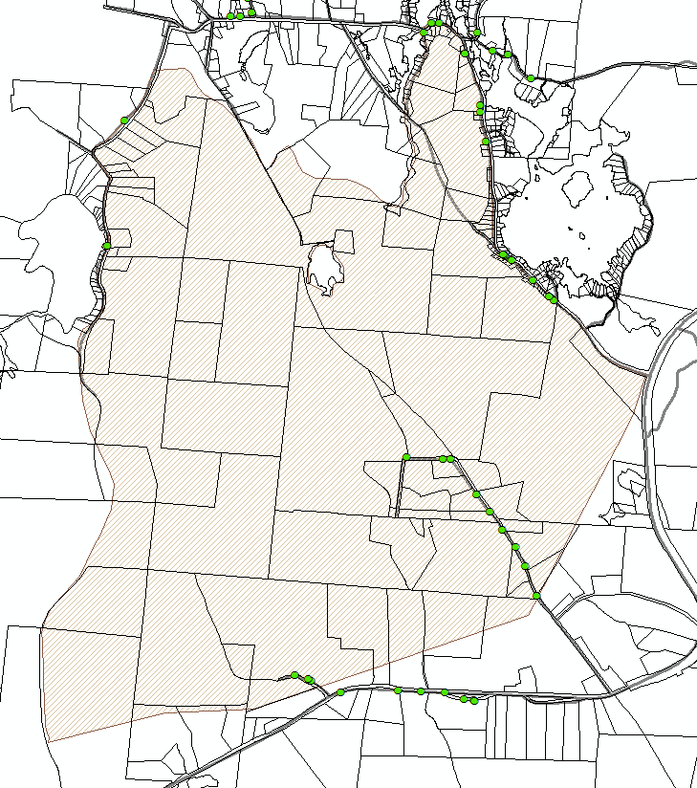
DETERMINING WORK SHARE ON-SCREEN EXAMPLE
Stoddard
66 Census HH
28 geocoded records
8 records had no matching parcel
Tracked time to move all points to rooftops
About 25 seconds per point

Slide 15
DETERMINING WORK SHARE DOING THE MATH
Determine number of points to be collected by each method
Estimate time to complete points under each method by community
Summarize by region
Determine cost
Other factors

Slide 16
DETERMINING WORK SHARE DOING THE MATH
Determine number of points to be collected by each method
Estimate time to complete points under each method
Summarize time by town and region
Calculate cost by town and region
Other factors

