Slide 1
Summary of GRANIT Clearinghouse Enhancement Proposal
Draft
September 5, 2019

Slide 3
Clearinghouse Responsibilities
(Extract from Commissioner Goulet presentation on 6/26/2019)
Coordinate acquisition, processing, storage, and distribution of free, public geospatial data
Develop and manage open geodata portal to provide access to public datasets
Develop and/or host map services, map viewers and other applications
Coordinate development of data guidelines and standards, procedural documents
Develop key foundational data sets (contours, impervious surfaces)
Participate in/coordinate data procurement opportunities (orthoimagery, LIDAR)
Provide training/technical support to GIS practitioners, potential practitioners, users

Slide 4
Key Elements of Proposal
Migrate GRANIT website to NH Geodata Portal
Add new elements to NH Geodata portal – current agency initiatives, agency apps
Populate OpenData database with current holdings – estimated 160 layers – and maintain
Develop and maintain customized tools to facilitate access to selected datasets (e.g. image subsetting tool)
Establish data sharing framework and guidelines for participating organizations in coordination with the Advisory Committee
Create mechanism/interface for streamlining submission of data
Conduct outreach and coordination with state agencies
Update/promote metadata standards
Work with partners to prioritize, document, and expose/share existing
Identify new agencies/organizations with data holdings of broad interest; explore data sets and identify those suitable for sharing
Work with partners to promote “initiatives” that are underway, including establishing new site(s) with user-contributed data
Integrate NH Geodata Portal with regional GIS resources
Inventory existing maps, apps, and other regional authoritative ArcGIS Online content using ESRI Hub
Organize content using standardized tags and other NH Geodata portal best practices
Highlight the use of NH Geoportal resources by supporting the development of new ArcGIS online resources by regional stakeholders
Coordinate with NH GIS Advisory Committee
Notes:
NH GRANIT currently hosts NHDES OneStop Data Mapper – one example of successful collaboration
Note focus is not only on data – but on map products (viewers), on project initiatives
Complement to NHDES proposal – which will support services and tools for QA/QC and thereby producing credible, authoritative data before GRANIT publishes/shares

Slide 5
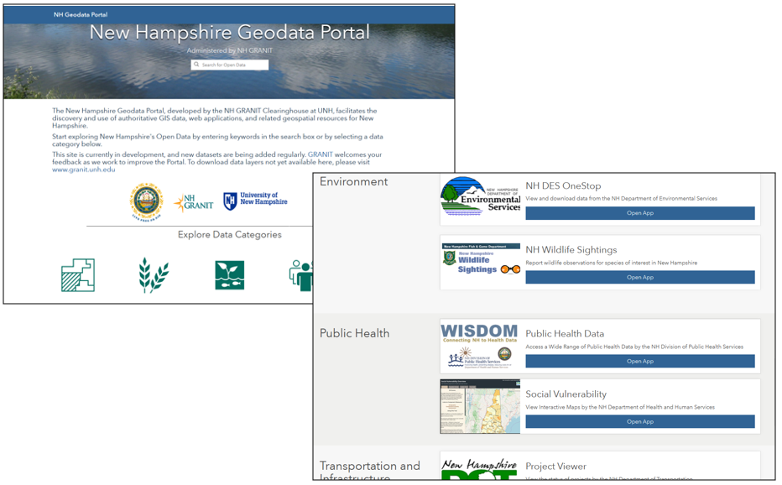

Slide 6
Primary Benefits to Stakeholders
Easily discoverable data, applications, dashboards, maps, and resources
Expanded and convenient tools to access data and resources – from any device, from anywhere, at any time
Expanded data holdings from state agencies, regional planning commissions, and other partners
Improved documentation of data sets
Enhanced, curated notifications to users of data, project, and resource updates

Slide 7
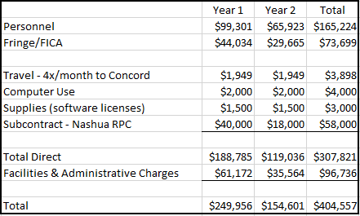
Proposed Budget
Notes:
The proposed budget includes 62 weeks of staff time in year 1 (project director for 10 weeks, 2 GIS analysts for 26 weeks each), and 40 weeks of staff time in year 2 (project director for 8 weeks, 2 GIS analysts for 16 weeks each). Additional components of the budget include weekly travel to Concord, a modest allocation for computer use, support for annual software licensing costs (Geocortex), and the subcontract with the Nashua Regional Planning Commission.

