Slide 1
Program Overview and Status Report: NH House/Senate Telecom Oversight Committee
October 4, 2012

Slide 2
Authority
Federal
American Recovery and Reinvestment Act (ARRA) through the National Telecommunications and Information Administration (NTIA)
Broadband Technology Opportunities Program (BTOP)
Term
5-year grant ending December 2014

Slide 3
Mission
The New Hampshire Broadband Mapping and Planning Program (NHBMPP) works to improve broadband access and use in the state by assessing broadband availability, and by engaging communities and other stakeholders in conducting planning, capacity building, technical assistance, and training initiatives.

Slide 4
Why Broadband?
For every 10% increase in broadband penetration in a state, employment is projected to increase by 2% to 3% (Brookings Institution, 2008)
For every $1 invested in broadband, the economic benefit is nearly $3 (US Bureau of Economic Analysis)
US investment in broadband and related information technology has driven 1/3 or more of the productivity growth of this decade (US Telecom Analysis)

Slide 5
NHBMPP Components
Mapping
Broadband Availability, UNH GRANIT
Community Anchor Institutions, NH RPCs & UNH GRANIT
Rural Addressing, NH RPCs & UNH GRANIT
Planning and Technical Assistance
Broadband Technology, NH DRED
Broadband Capacity Building, NH DRED, NCIC
Broadband Technical Assistance Training, UNH CE & NH OEP
Regional Broadband Planning, NH RPCs & NH OEP

Slide 6
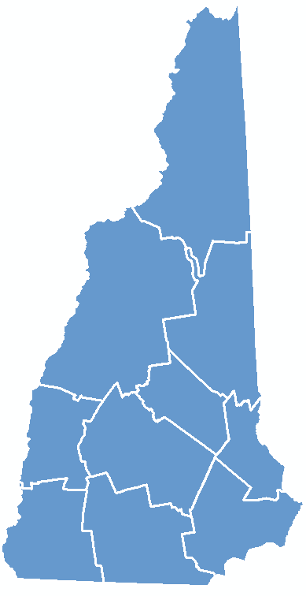
Broadband
Planning

Slide 7
Broadband Planning
Develop nine regional broadband plans that will be consolidated into a statewide broadband plan
Coordinated by 9 Regional Planning Commissions
Form Regional Broadband Stakeholder Groups
Assess community and regional broadband needs and barriers
Utilize data collected from stakeholders and mapping components to develop strategies for addressing broadband barriers

Slide 8
Broadband Planning – Status
Regional Broadband Stakeholder Groups (BSGs) established; meet quarterly
Identified regional broadband needs and barriers
Developed outline of regional plan content
Each region holding first (of three) public forums
Southwest Region Public Broadband Forum September 27, 2012 at the Dublin Public Library

Slide 9
Broadband Capacity Building

Slide 10
Broadband Capacity Building
Leadership Role to increase broadband adoption and deployment on a targeted community-by-community basis, collaborating to create best case practices in:
Policy
Management
Financial Resources
Advocacy for Business and Residential Broadband

Slide 11
Broadband Capacity Building
Working with Northern Communities Investment Corporation (NCIC), assist communities in their development of broadband projects by:
Establishing Resource Teams (broadband sector experts)
Utilizing Demand/Aggregation/Planning Tools for Municipalities
Creating model Broadband Implementation Business Plans

Slide 12
Broadband Technical Assistance & Training

Slide 13
Broadband Technical Assistance & Training
Assess broadband technical and training needs of targeted sectors
Develop tools and learning modules relative to broadband
Deliver technical assistance and training to targeted sectors

Slide 14
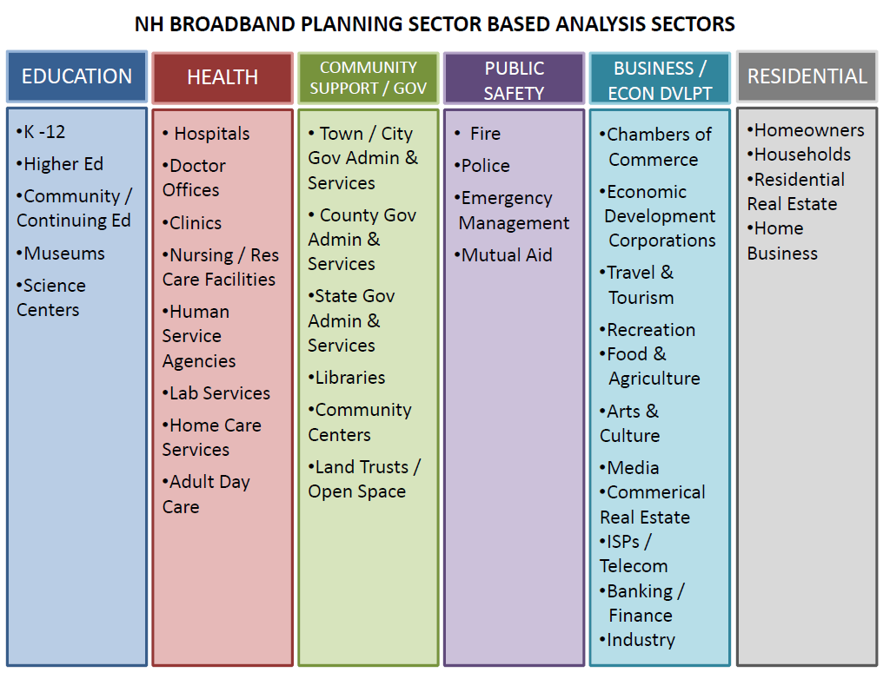
Targeted Sectors

Slide 15
Broadband Technical Assistance & Training - Status
Surveys completed for Education, Health, Municipal and Business sectors
Learning modules being
finalized
Training sessions conducted
including: using GIS/GPS technologies;
“Putting your Business on the Digital Map”;
“Leveraging Broadband for Economic Development”

Slide 16
Mapping Broadband Availability

Slide 17
Mapping Broadband Availability – Overview
Goal – map broadband availability by type of technology and speed, in order to identify areas served, unserved, and underserved in the state
Broadband defined by NTIA as 768 kbps downstream and 200 kbps upstream
Based on data submitted by broadband providers in the state
Data aggregated to census block geography for analysis and display
Multi-source data verification methodology utilized
Data collected and processed by UNH; submitted to NTIA on a 6-month cycle (March 31, September 30) for inclusion in the National Broadband Map (http://broadbandmap.gov)

Slide 18
What is broadband?
NHBMPP Category | Download Speed | Upload Speed | Typical Uses (additive to level above)
Unserved | < 768 Kbps | < 200 Kbps | Email
Underserved | 768 Kbps to < 3 Mbps | 200 Kbps to < 1.5 Mbps | Web browsing and shopping Sending/receiving medium-size files (photos, word processing) Limited streaming content; buffering a concern 1-3 simultaneous internet devices Voice over IP
Served | 3 Mbps + | 1.5 Mbps + | Sending/receiving large files Streaming HD content; buffering not a concern VPN access; where speed of operation critical to job function 5+ simultaneous internet devices Multi-player online gaming HD quality videoconferencing Teleworking Real-time HD medical imaging and consultation “Internet 2” connectivity and applications
Notes:
Note key definition of broadband – 768 kbps down and 200 kbps up
Availability mapped from data reported by providers, based on services they currently deliver or can deliver within 10 business days
But we recognize these speeds are not adequate for many of today’s applications, so for NH purposes, we are proposing a “use case” based definition of served/unserved/unserved areas of the state.

Slide 19
Participating NH Broadband Providers (39 as of Fall, 2012)
Cable (5)
Argent Communications, LLC (also Fixed Wireless)
Charter Communications Inc.
Comcast Cable Communications, LLC
MetroCast
Time Warner Cable
Fixed Wireless (9)
Cyberpine Cooperative, Inc.
Great Auk Wireless
IAMNOW.net
Lakes Region Wireless
Spectra Access
Tamworth Wireless Cooperative
Wave Comm, LLC
Wireless LINC of NH and VT
WiValley
Fiber (2)
Level 3 Communications (also Middle Mile)
Topsham Communications
Middle Mile (5)
DSCI Corporation
Freedom Ring Communications
Lightower Fiber Networks
Oxford Networks
Sidera Networks, LLC
DSL (9)
Covad Communications Company (also Other Copper Wireline, Middle Mile)
Dunbarton Telephone Company, Inc.
FairPoint Communications, Inc.
G4 Communications (also Middle Mile)
Granite State Communications (also Fiber)
GWI (also Other Copper Wireline)
OTT Communications (also Middle Mile)
Sovernet Communication
TDS Telecom (also Fiber, Middle Mile)
Mobile Wireless (5)
AT&T Mobility, LLC
Sprint
T-Mobile
U.S. Cellular
Verizon Wireless
Satellite (4)
HughesNet
Skycasters
StarBand Communications, Inc.
WildBlue Communications, Inc.
Notes:
We know of 60+ active providers in the state, but have received data from the 39 listed above. Several others have indicated they intend to participate; while others have been essentially nonresponsive to our multiple requests for data.

Slide 20
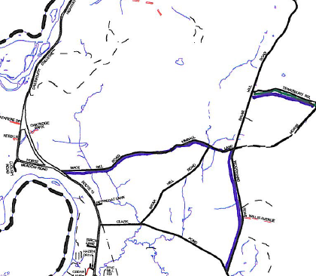
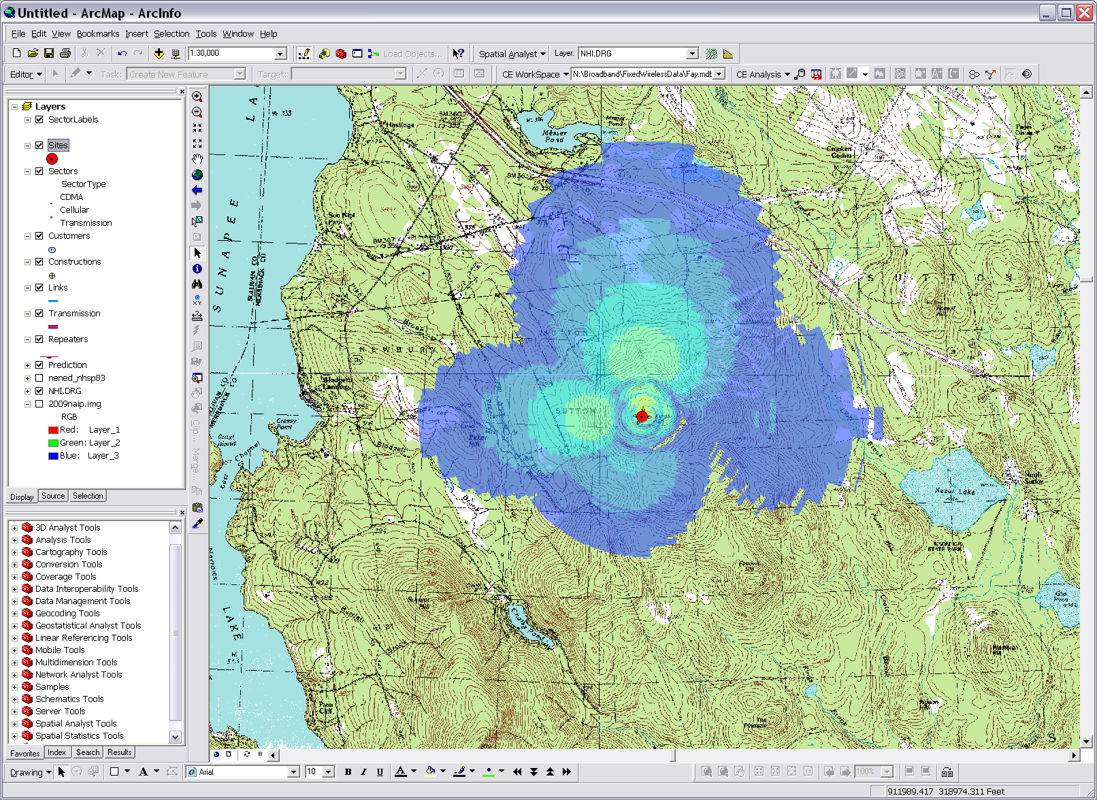
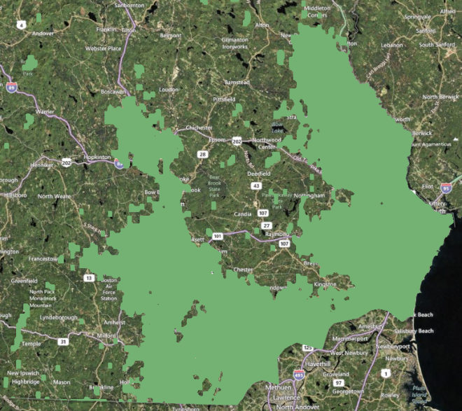
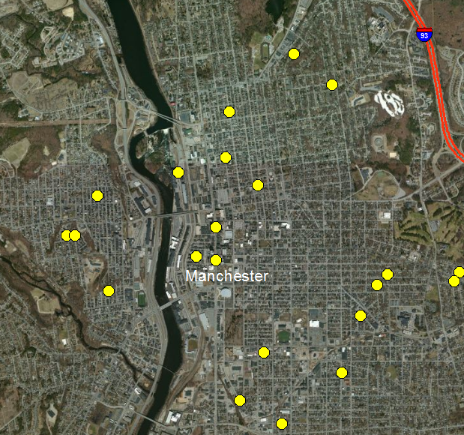
Processing Provider Data
Submission:
Marked-up county road map.
Submission: Spreadsheet.
Cellular Expert software (www.cellular-expert.com) predicts signal strength based on tower data. Note: Map is for display purposes only, and does not represent the coverage of any individual service provider.
Submission:
Mapped coverage area.
Submission:
Address data file.

Slide 21
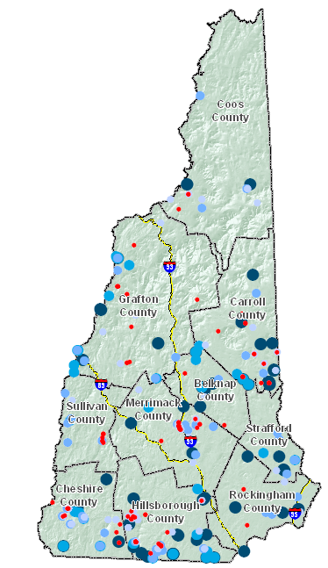
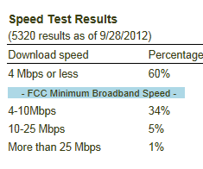
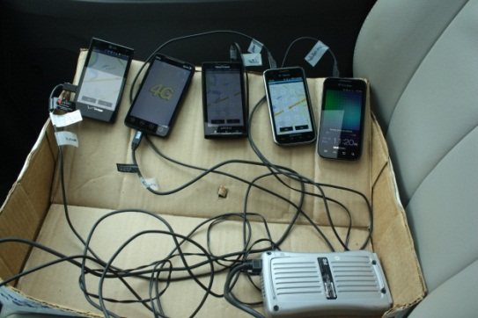
Broadband Availability – Data Validation
Consumer Surveys
Speed Tests
Drive Tests
Others Data Sources
Commercial data sets
Data reported to FCC (477 data)
Satellite dish inventories
Community meetings
(3500+ miles of Interstates, US & State routes driven)
Notes:
Currently have over 500 survey records, and over 5,000 speed tests.
Speed test – red = no service, light blue = under the 4 Mpbs, dark blue = 4 Mbps +
Completed drive test in summer of 2012.

Slide 22
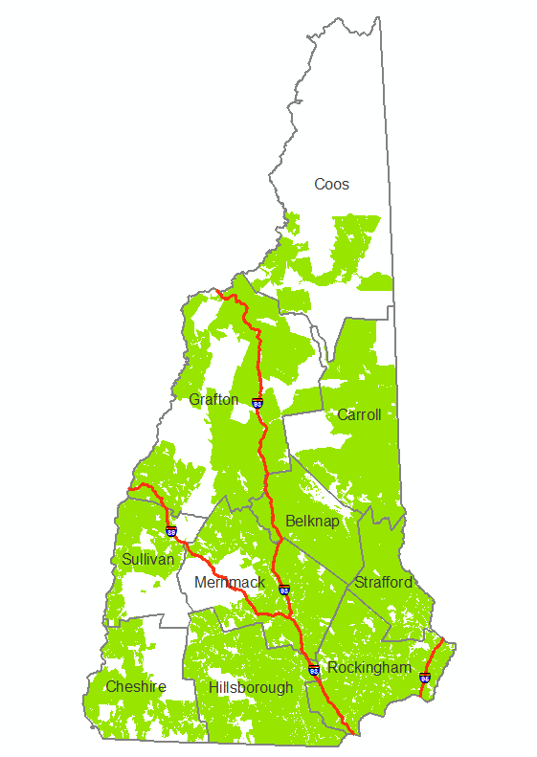
Cable Service Broadband Availability – March 2012 Results

Slide 23
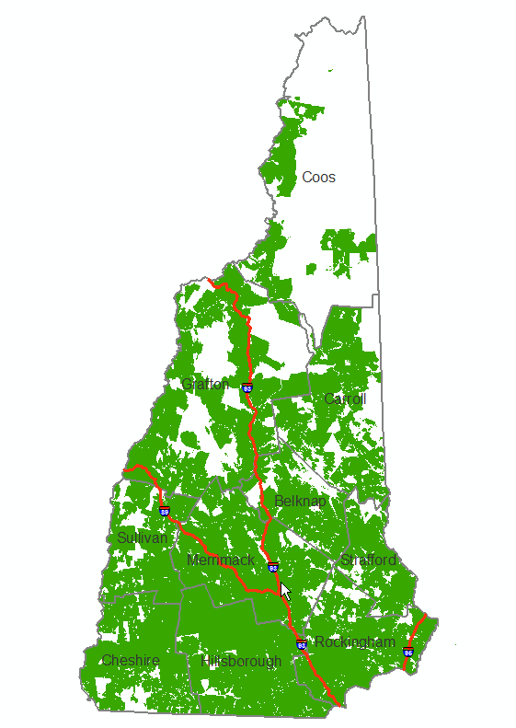
DSL Service Broadband Availability – March 2012 Results

Slide 24
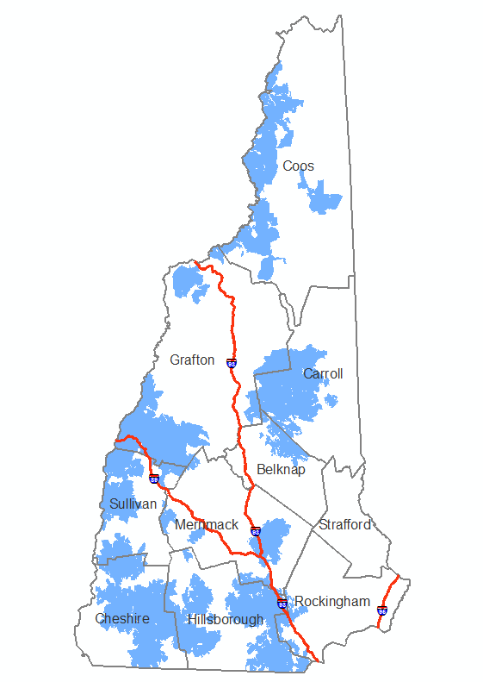
Fixed Wireless (WISP) Service Broadband Availability – March 2012 Results

Slide 25
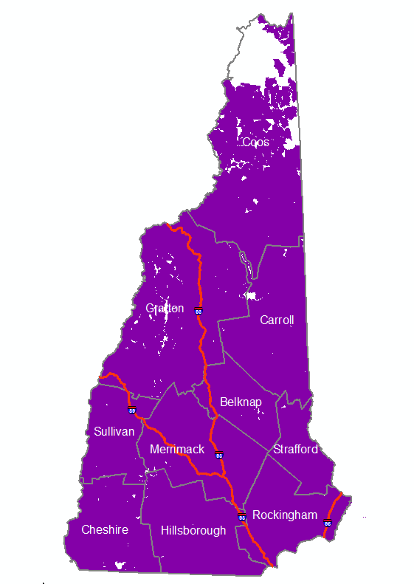
Cellular Service Broadband Availability – March 2012 Results

Slide 26
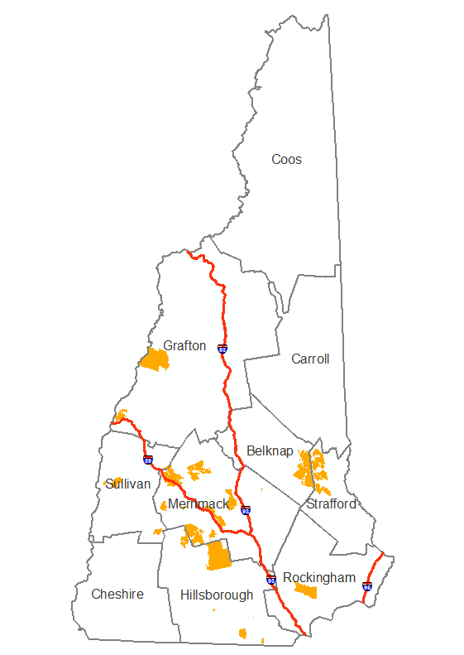
Optical/Fiber Service Broadband Availability – March 2012 Results

Slide 27
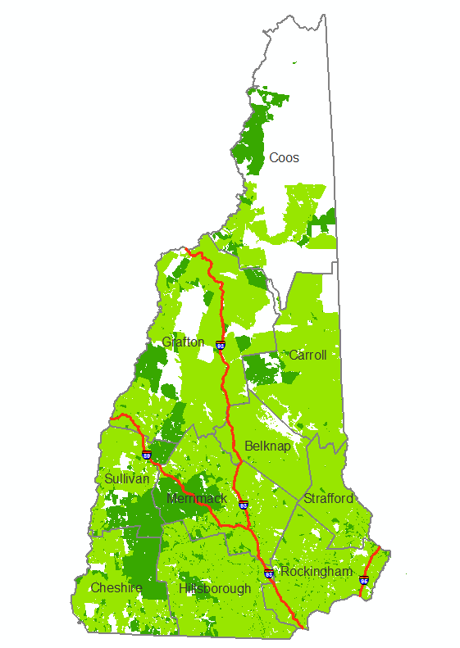
Wireline Service Broadband Availability – March 2012 Results

Slide 28
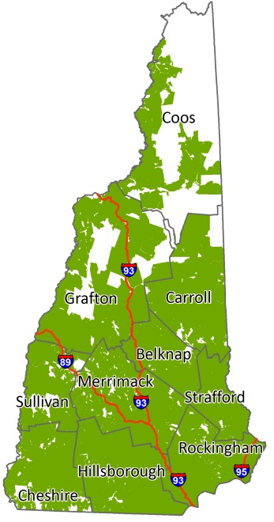
Broadband Availability – Download speed of 3 Mbps+ - March 2012 Results
What you can do:
Email
Web browsing and shopping
Moderate social media use
Voice over IP
Limited VPN
Send/receive medium-size documents
Status as of March 2012

Slide 29
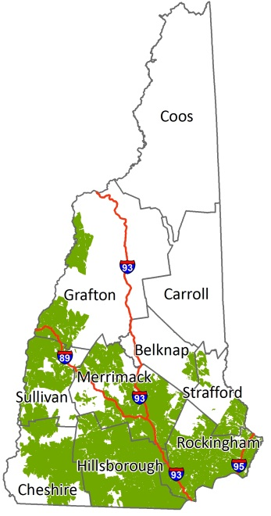
Broadband Availability – Download speed of 25 Mbps+ - March 2012 Results
What you can do:
High-definition videoconferencing
High speed business to business applications
“Smart homes” and teleworking
High-definition audio-video streaming
Real-time medical imaging & consultation
Send/receive large documents
Status as of March 2012

Slide 30
Community Anchor Institution Inventory

Slide 31
Community Anchor Institutions – Overview
Goal – statewide layer of community anchor institutions (CAIs) with associated broadband access information
For October 2012 submission:
Six-month update/verification cycle; continuing “gap” analysis to identify new CAIs
Category | No. | % of Total
1. School – K-12 | 762 | 19.5%
2. Library | 766 | 19.6%
3. Medical/health care | 808 | 20.7%
4. Public safety | 564 | 14.5%
5. University, college, other post-secondary | 64 | 1.6%
6. Other community support – government | 736 | 18.9%
7. Other community support - non governmental | 199 | 5.1%
TOTAL | 3,899 | 100.0%

Slide 32
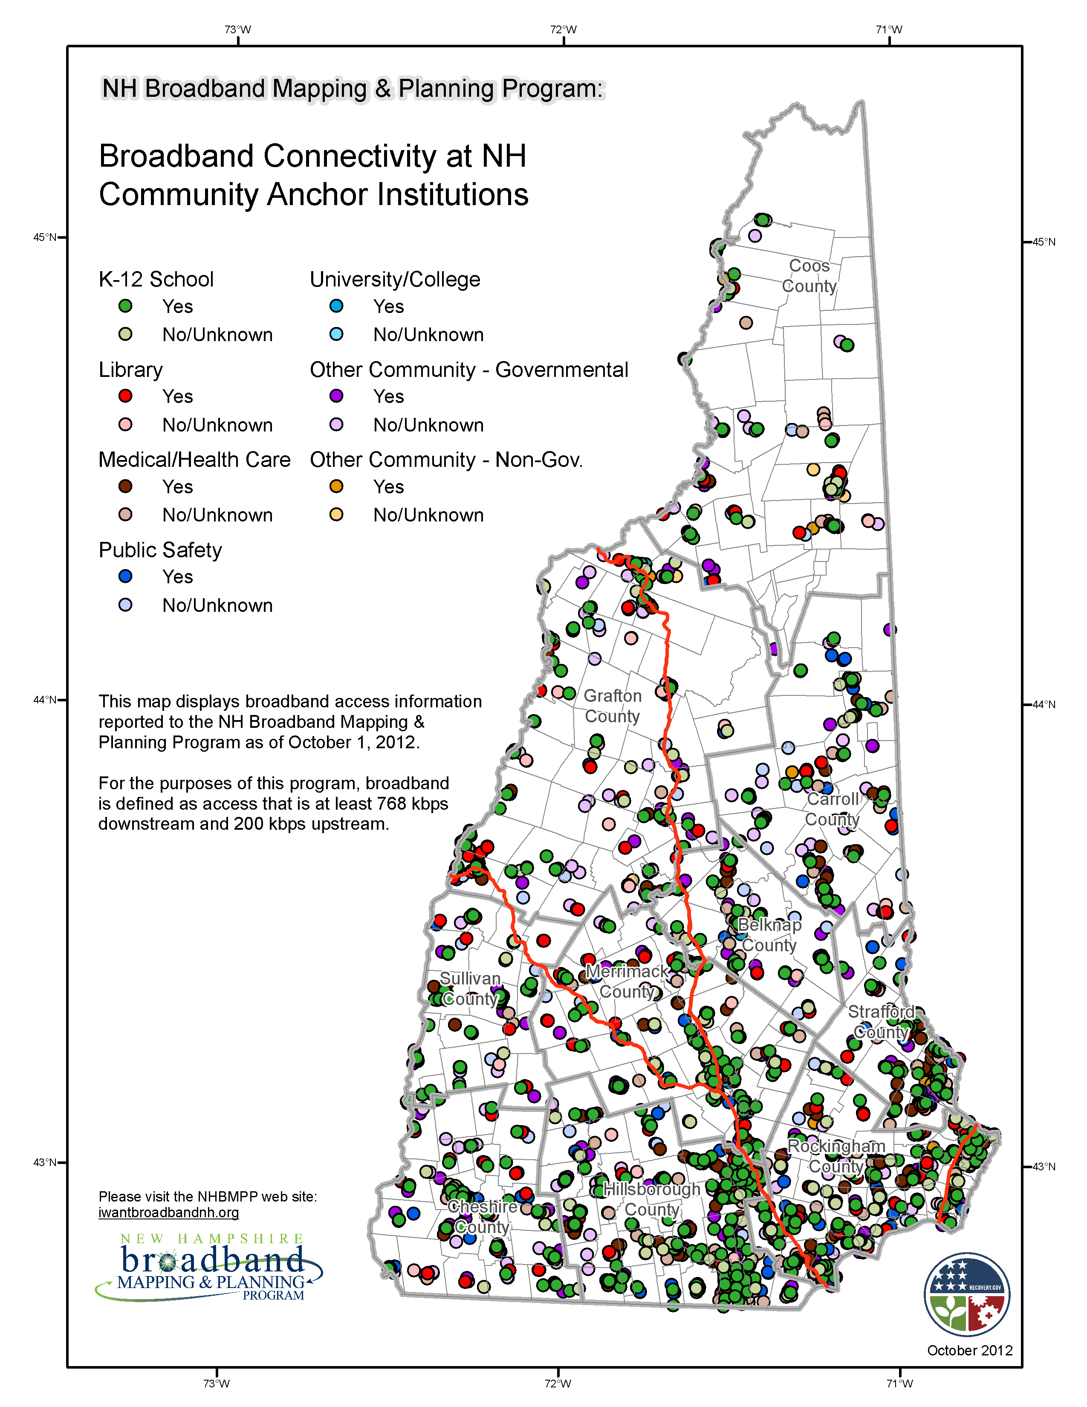
Community Anchor Institutions – October 2012
Notes:
Data as of October, 2012
Darker colors shows that an institutions has access to broadband which is defined as 768 kbps down and 200 kbps up and the lighter colors are those that do not have access to broadband.

Slide 33
Rural Addressing Data Collection

Slide 34
Rural Addressing – Overview
Goal – statewide GIS point file of addresses in NTIA-designated rural census blocks (2+ sq mi)
~40,000 households in rural blocks (Census 2010)
Existing address datasets either incomplete, or unavailable to the public
Data collected at the RPC level and coordinated by Nashua Regional Planning Commission and UNH

Slide 35
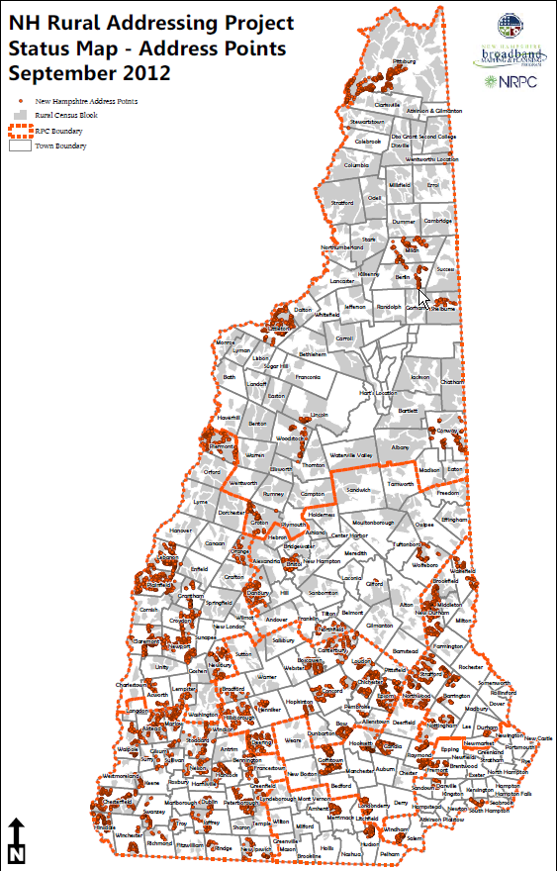
Rural Addressing – Status
14,600+ addresses collected (36.5% of total)
200+ volunteer hours

Slide 36
Supplemental Mapping Activities

Slide 37
Broadband Availability – Supplemental Activities
Public wi-fi location mapping
Municipal cable franchise agreement inventory
Enhancement of CAI data collection for additional category types
Cell tower location updating

Slide 38
Broadband Data & Map Products

Slide 39
Data Sets and Map Products
From GRANIT website, www.granit.unh.edu
downloadable GIS shapefiles
From NHBMPP website, www.iwantbroadbandnh.org
interactive map viewer
downloadable statewide maps
downloadable town broadband availability profiles
Aggregate datasets of all 56 state broadband initiatives can be viewed on the National Broadband Map, www.broadbandmap.gov

Slide 40
iwantbroadbandnh.org

Slide 41
Broadband Availability –
Municipal Profiles
Notes:
The NHBMPP mapping program has also created community profiles to see broadband availability by census block this is accessible by the website iwantbroadbandnh.org. The maps shows technology with the fastest reported download speed and id what service providers are available.

Slide 42
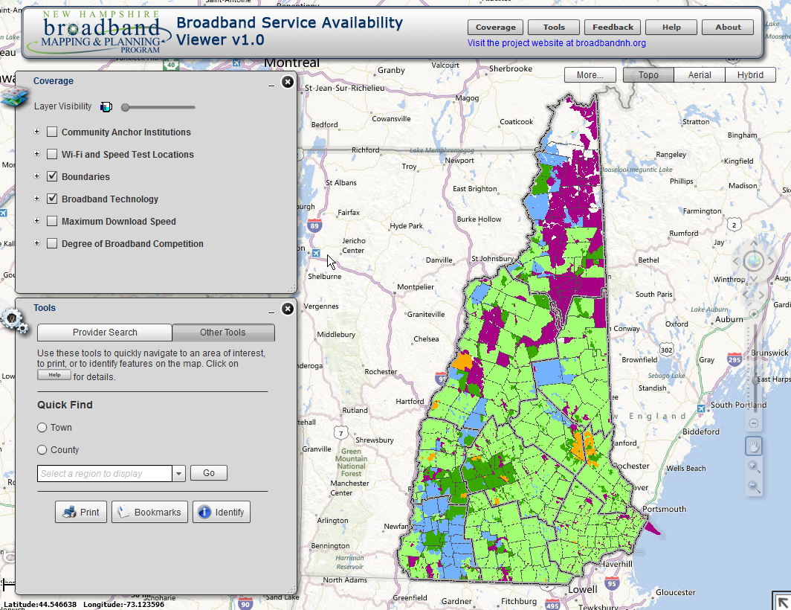
Broadband Availability – Interactive Map Viewer

Slide 43
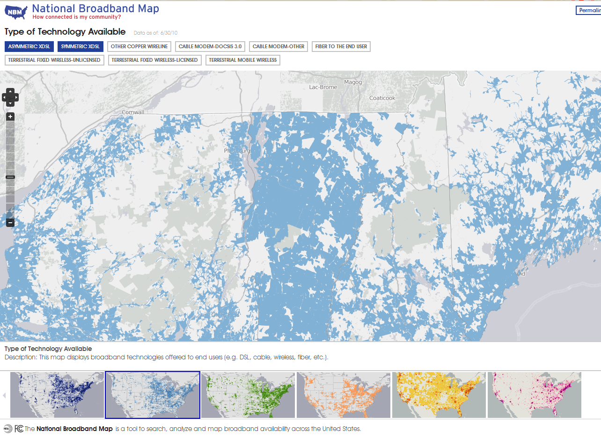
Broadband Availability – National Broadband Map (www.broadbandmap.gov)
Launched February 17th, 2011 by NTIA in collaboration with the FCC, and in partnership with the 50 states, five territories and the District of Columbia broadband mapping programs

Slide 44
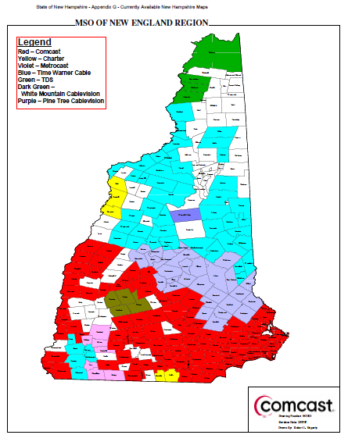
Evolution of Broadband Mapping in NH: 2008
Static
Town-based data
No planned updates
Information for selected technologies (DSL, Cable) on:
Coverage
From “State of New Hampshire Broadband Action Plan”, Department of Resources and Economic Development and the NH Telecommunications Advisory Board, June, 2008

Slide 45
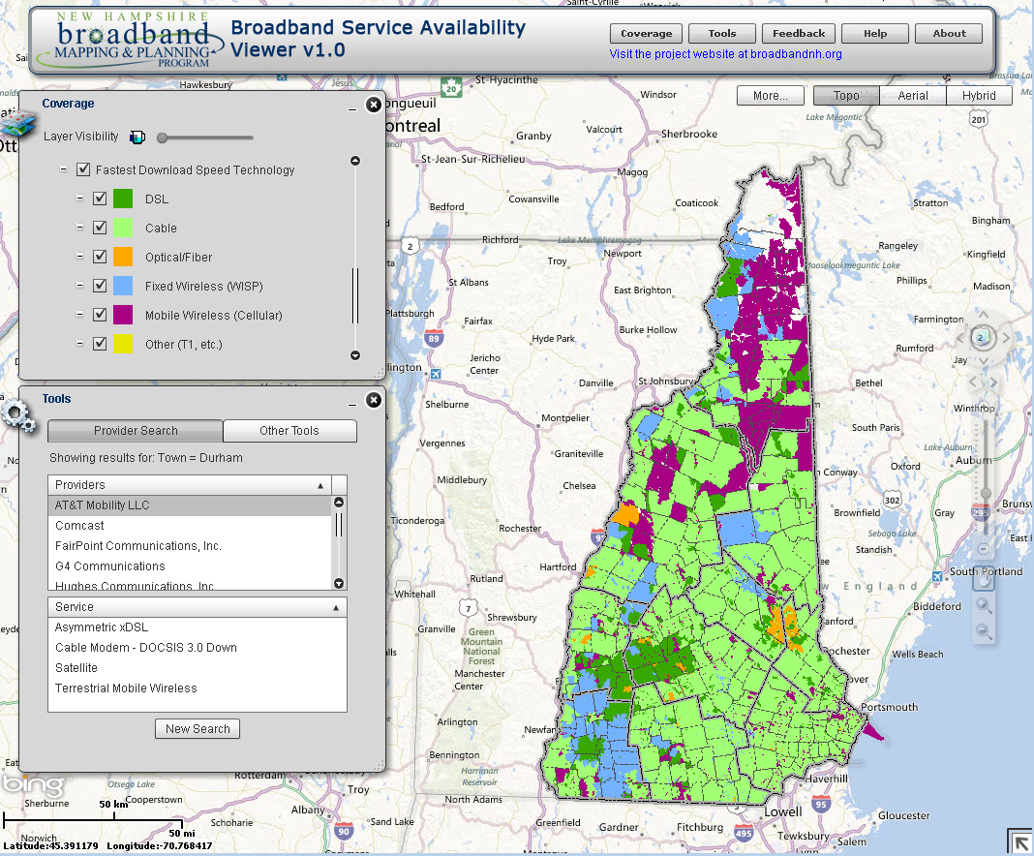
Evolution of Broadband Mapping in NH: 2010/2011
Interactive
Census block resolution
Regularly updated
Information for all technologies on:
Coverage
Technology
Speed tiers
Links to provider websites to obtain pricing data
Data as of March, 2012

Slide 46
Key Benefits of NHBMPP Mapping
1. Comprehensive mapping capability
Maintaining and verifying statewide broadband availability coverage map with speed and technology attributes, updated every 6 months
Exposing unserved and underserved areas of the state
Verifying unserved and underserved areas - user speed tests, surveys, direct emails, cellular drive testing
Making extensive use of GIS and web technologies to collect, process, and verify data; to conduct spatial analyses; to present results to the public
Developing and maintaining additional core data sets - Community Anchor Institutions, public rural address data
Compiling supplemental data sets - cable franchise agreements inventory, public wi-fi locations
2. Strong relationship with internet service providers
Returning broadband coverage maps to providers, several with limited mapping capability
Providing feedback on unserved and underserved areas of NH
3. Extended broadband community in NH
Encouraging state broadband initiatives to work collaboratively, sharing data and knowledge
Promoting public engagement in issues around broadband availability
Notes:
Maps are standardized – can be aggregated with results from other states to generate national broadband map
Rural addressing data set – many other applications

Slide 47
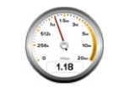
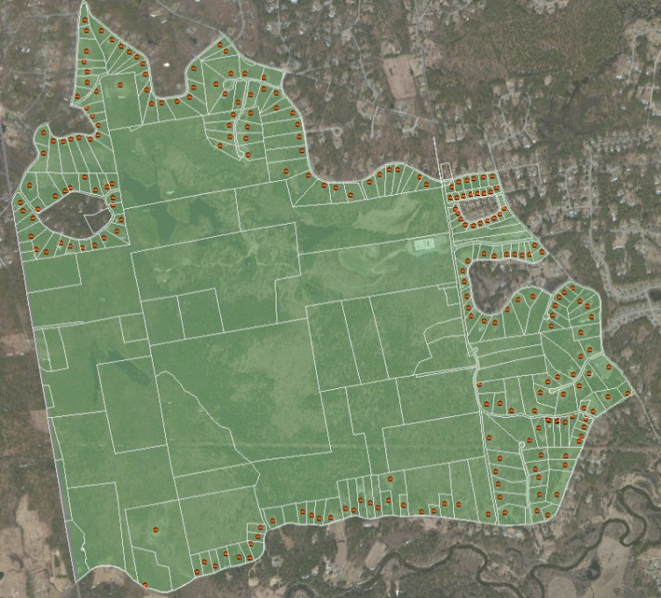
Evolution of Broadband Mapping in NH: The Future?
Validation & feedback
Every user is a potential data collector
Customer and provider feedback loops
Better maps
Address level mapping
High‐capacity maps for economic development
Direct updates from providers

Slide 48
How you can help
Recognize NH needs to expand broadband access and adoption in order to remain competitive with other states
Spread the word that broadband is essential for economic development and vibrant communities
Support NHBMPP and a state broadband authority/office, ensuring a continued capacity to deliver support to communities, businesses, schools, libraries, hospitals, etc.

Slide 49
How you can help
Encourage data sharing among publically-funded data initiatives
Incentivize provider participation in the NHBMPP and beyond
Acquire statewide LiDAR to improve wireless signal propagation modeling capability
Support UNH GRANIT and RPCs in providing data and technical resources

Slide 50
How you can help
Encourage collaboration of public - private partners working together to enhance broadband access and adoption throughout the state
Support legislation and policy designed to promote broadband access and adoption in NH
Participate by attending our events; visiting our website at: iwantbroadbandnh.org
(take the speed test and survey)

Slide 51
Project Contacts at UNH
Fay Rubin, Principal Investigator, NHBMPP
and NH GRANIT Project Director
fay.rubin@unh.edu
Scott Valcourt, co-Principal Investigator, NHBMPP
and Director of Strategic Technology
scott.valcourt@unh.edu
Michael Blair, Project Coordinator, NHBMPP
michael.blair@unh.edu
David Foote, Manager, Broadband Planning, NHBMPP
david.foote@unh.edu

