Slide 1
Project Overview LIDAR for the Northeast
Rick Chormann, NH Geological Survey
NH Dept. of Environmental Services
Fay Rubin, GRANIT
University of New Hampshire
Northeastern Section of the Geological Society of America
March 17-19, 2013, Bretton Woods, NH

Slide 2
Project Timeline
Fall 2008 - UNH proposal covering watersheds in NH and ME developed
Spring/Summer 2009 – ARRA funding indicated, project idea grows to NE/NY
November 2009 –Proposal submitted to USGS, $2.7M total budget, $1.4M requested from ARRA funding
January 2010 – Award letter announces full funding of the project
Spring/Summer 2010 – Additional funding brought forward to further increase project footprint and products
June 2010 – first task order issued for ARRA-funded portion to Photo Science
September 2010 – second task order issued for all other funding portion to Photo Science
Final project was approximately 8,000 sq miles of new data
Northeastern Section of Geological Society of America March 17-19, 2013
Notes:
Concept started with proposal from UNH to collect LIDAR for 2 watersheds extending into Maine in 2008
Discussions between 2 states expanded to all of NE when ARRA funding was announced in 2009, and eventually extended to include NY

Slide 3
Coordination
Each state worked through its state coordinator for non-profit and state level funding requirements and for technical specifications
USGS liaisons coordinated other federal contributions
Maine state GIS manager (Michael Smith) coordinated all state and federal components, acted as principal investigator
NGTOC handled contracting through Geospatial Products and Services Contract v2 (GPSC-2)
Northeastern Section of Geological Society of America March 17-19, 2013
Notes:
Much of success of project = initiative of Mike Smith, Maine GIS with valuable tech. assistance from USGS.
Also a reflection of the GIS network that exists in NE. Many of the players have been in their positions for a number of years so there are already trusted avenues of communication.
Baseline technical specification established cooperatively as USGS Base LIDAR Specification V12; each state could then “buy up” if they found funds to cover additional cost

Slide 4
Project Funding
States | Federal | Other
Maine | USGS – National & Local | The Nature Conservancy
New Hampshire | NRCS – State & Regional | Maine Coast Heritage Trust
Massachusetts | FEMA | Maine Geolibrary
Rhode Island | US DOT | Maine DEP and Maine SPO
Connecticut | National Park Service | University of NH
New York |  | NH DES
 |  | NY DEC
 |  | NY Energy Research Dev. Authority
Northeastern Section of Geological Society of America March 17-19, 2013
Notes:
Proposal – included commitments from multiple entities – state agencies, federal agencies, non-profit
Application included letters of support from ~40 others – towns, regional organizations, universities, non-profits - demonstrated widespread support/interest

Slide 5
Project Benefits
Economic stimulus for collectors/providers, analysts, engineers, planners, scientists, consultants, etc.
Multi-state and federal collaboration, exemplifying “good government” and model for the national elevation program
Coordinated collection and processing effort, resulting in real taxpayer savings (map it once, used by many)
Data freely available to the general public (via USGS CLICK)
Northeastern Section of Geological Society of America March 17-19, 2013
Notes:
Proposal emphasized a number of project benefits, including those listed. (Note that ARRA required the economic stimulus piece.)

Slide 6
Project Manager: USGS NGTOC
Task Order Administration
Task Order Management
Client/Producer Liaison
Technical Domain Expertise
Independent Quality Assurance Testing
Deliverable Validation & Acceptance
Data Dissemination
Northeastern Section of Geological Society of America March 17-19, 2013
Notes:
USGS role – critical. National Geospatial Technical Operations Center (NGTOC) provided essential support
Re Data Dissemination – all data in public domain. Delivered to each state, but also archived in CLICK for national distribution

Slide 7
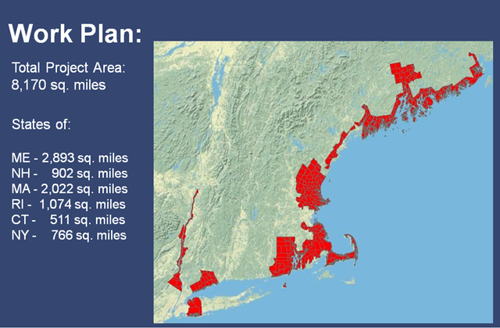
Project Work Plan
Northeastern Section of Geological Society of America March 17-19, 2013

Slide 8
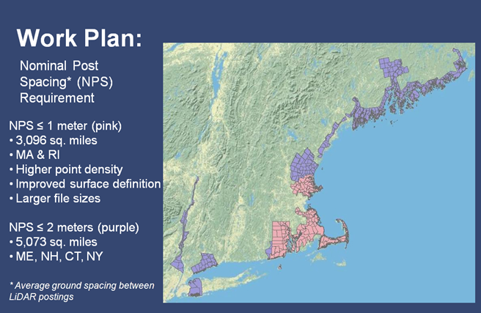
Project Work Plan
Northeastern Section of Geological Society of America March 17-19, 2013
Notes:
Note differential technical specs:
ME/NH/CT/NY – basic LIDAR spec, V12, including hydro flattening
RI/MA – “bought up” to higher resolution.

Slide 9
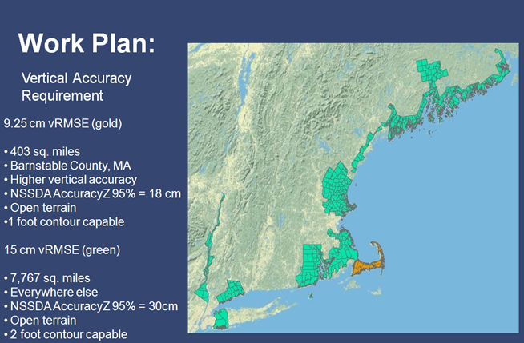
Project Work Plan
Northeastern Section of Geological Society of America March 17-19, 2013

Slide 10
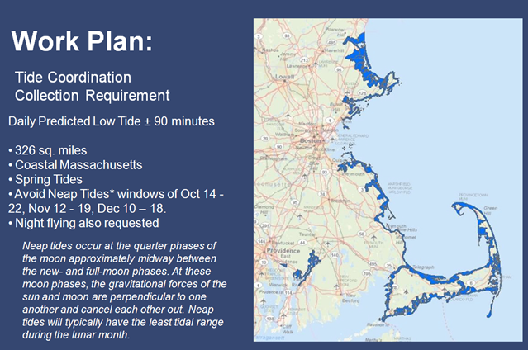
Project Work Plan
Northeastern Section of Geological Society of America March 17-19, 2013
Notes:
Again, emphasis on flexibility of states to determine their own requirements

Slide 11
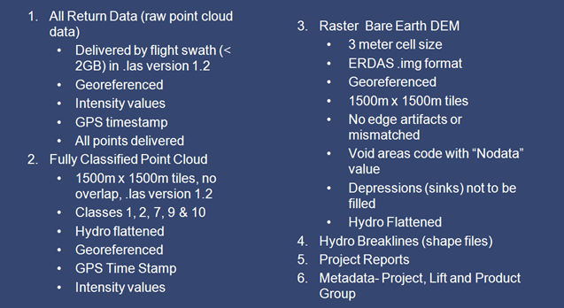
Project Deliverables
Northeastern Section of Geological Society of America March 17-19, 2013

